Slide 1


VISVESVARAYA TECHNOLOGICAL UNIVERSITY,BELAGAVI
Mini Project
On
“HOTEL MANAGEMENT SYSTEM”
Submitted by
HARSHITHA S (1EE21CS019)
In partial fulfilment of
BACHELOR OF ENGINEERING
IN
COMPUTER SCIENCE AND ENGINEERING
Under the guidance of
Guide:
Dr. Kumuda N S
Associate Professor,
Dept. of CSE
HOD:
Dr. Lavanya N L
Head,
Dept. of CSE
EAST WEST COLLEGE OF ENGINEERING
Yelahanka New Town, Bangalore-560064
2023-24

Slide 2
INTRODUCTION
Project overview :
The Hotel Management System is a comprehensive solution designed to ease operations in the hospitality industry. It offers a range of functionalities to manage various aspects of hotel operations, including reservations, guest management, room allocation, billing, and reporting.
Objectives :
Efficient Reservation Management
Streamlined Check-in and Check-out
Accurate Room Allocation
Comprehensive Billing System
System Architecture :
Our Hotel Management System follows a client-server architecture:
Client-Side: HTML, CSS, and JavaScript are used to create the user interface and handle user interactions.
Server-Side: PHP is used to process user requests, interact with the MySQL database, and generate dynamic content.

Slide 3
System Specifications
Software Requirement
Operating System: Windows
Web browser : Google Chrome, Mozilla, Windows Explorer
Web-Technology : PHP
Front-End : Html, CSS, Bootstrap, Sublime Text, Swiper js, Java Script
Back-End : MY SQL
Web Server : Apache SERVER, XAMPP SERVER
Hardware Requirements
Pentium IV Processor
256 MB Ram
512 KB Cache Memory
Hard disk 10 GB

Slide 4
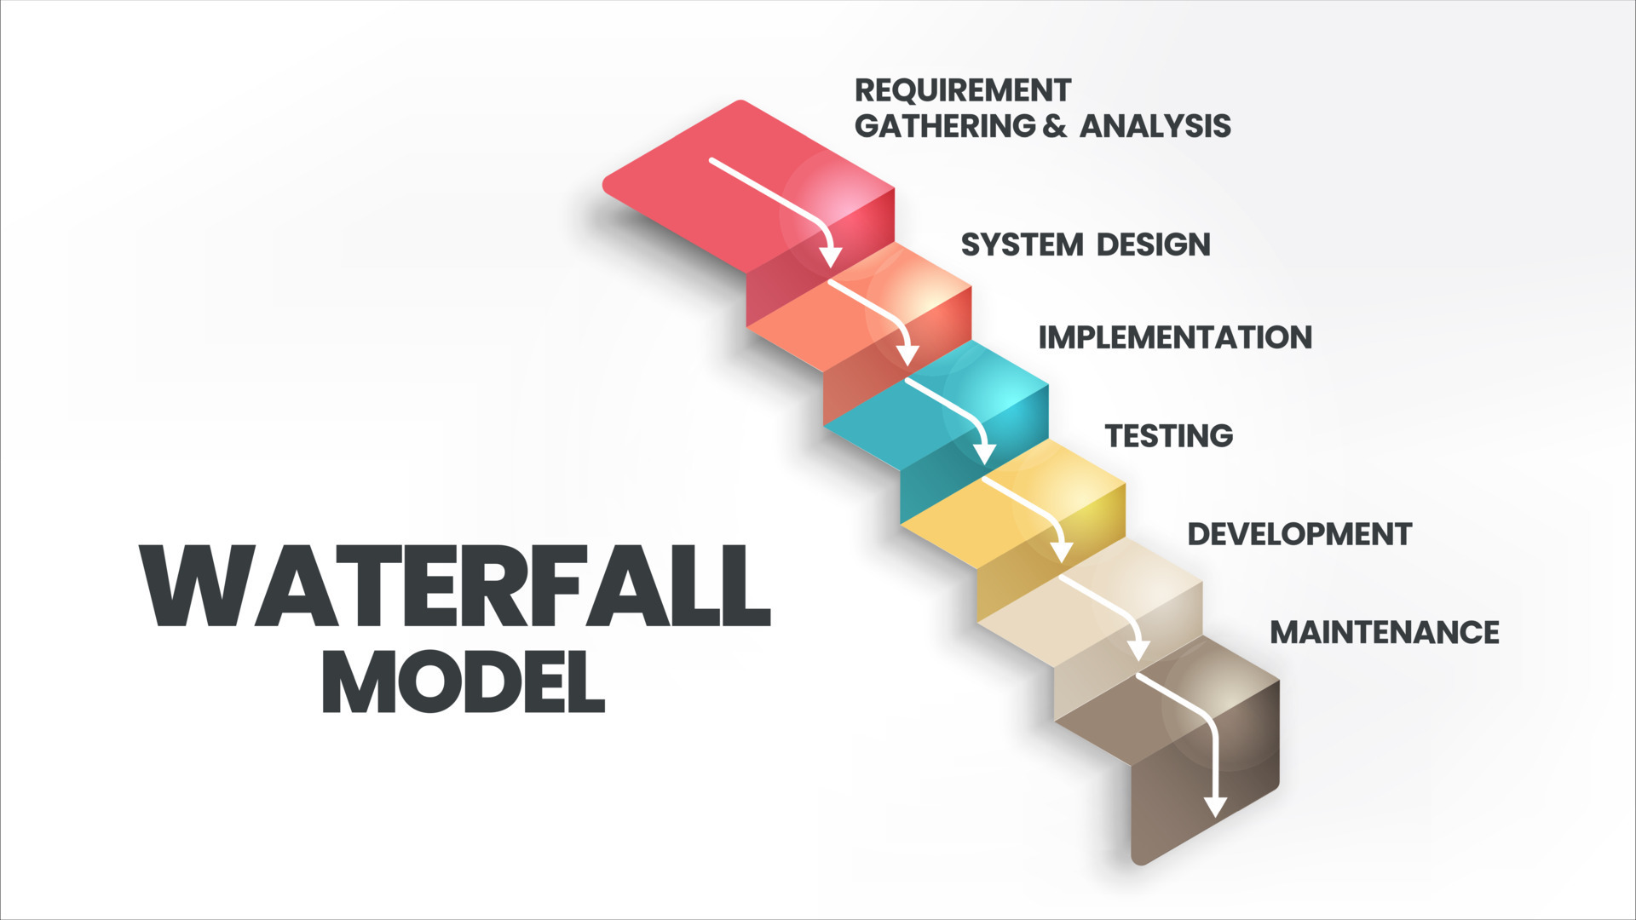
Methodology of Development
Requirment Gathering and Analysis :
All possible requirements of the system to be developed are captured in this phase.
System Design :
This system design helps in specifying hardware and system requirements and helps in defining the overall system architecture.
Implementation :
With inputs from the system design, the system is first developed in small programs called units and tested for its functionality
Integration and testing :
All the units developed in the implementation phase are integrated into a system after testing of each unit.
Development
Once the functional and non-functional testing is done the product is deployed.
Maintenance :
There are some issues which come up in the client environment. To fix those issues, patches are released.

Slide 5
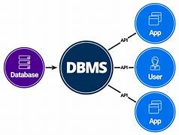
Structure of The Project
ADMIN PANEL :
Login
Status
View Booking
View Rooms
View payment’s
News Letter
Logout
USER PANEL :
View rooms
View Gallery
View services
Book

Slide 6
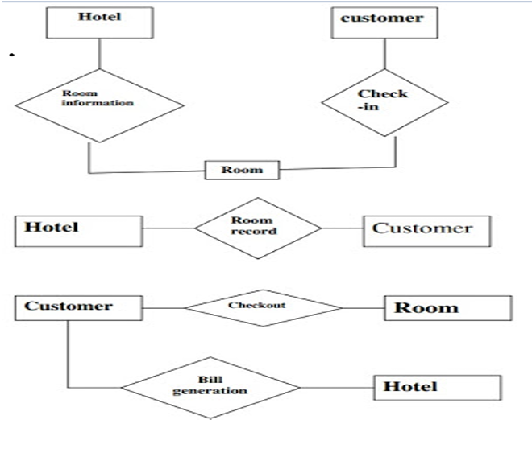
System Design Flow Chart

Slide 7
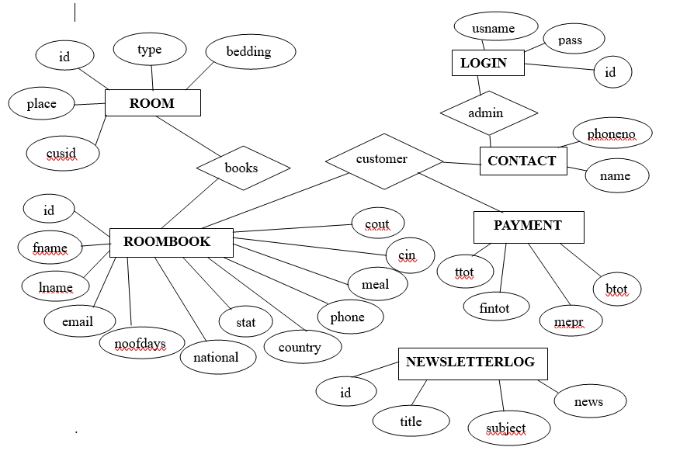
E-R DIAGRAM
1
n
1
1
1
1
An Entity-Relationship (ER) diagram is a graphical representation of entities and their relationships in a database.

Slide 8
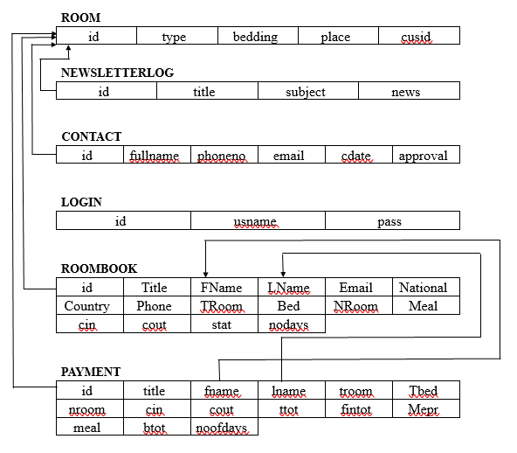
SCHEMA DIAGRAM

Slide 9
ADVANTAGES
Efficient Reservation Management: Simplify the process of making and managing reservations for guests.
Streamlined Check-in and Check-out: Facilitate smooth check-in and check-out processes for guests.
Accurate Room Allocation: Ensure optimal allocation of rooms based on availability and guest preferences.
Comprehensive Billing System: Generate accurate bills and invoices for guests, including room charges and additional services.
Robust Reporting: Provide comprehensive reporting capabilities for analyzing hotel performance and trends.

Slide 10
CONCLUSION
In conclusion, our Hotel Management System is a powerful tool designed to streamline hotel operations, enhance guest experiences, and improve overall efficiency. With its user-friendly interface and robust features, it is poised to revolutionize the way hotels manage their day-to-day activities.
Utmost care and back-up procedures must be established to ensure 100% successful implementation of the computerized hotel system.
This system will help administration to work easily. Because of its easy access and less time consuming administration can get the information of the Users, Rooms, Payments, etc. They do not have to search in the paper file for the log time. Members an easily handle the system.

